Slide 1
Lisence Number Plate Detection
Submitted to : Sir Nabeel
Presented By:
- Mehfooz Ali - Malaika Sohail
- Mamoona - Abdul Rauf
- Wajid Hussain - Mohd. Hammad

Slide 2
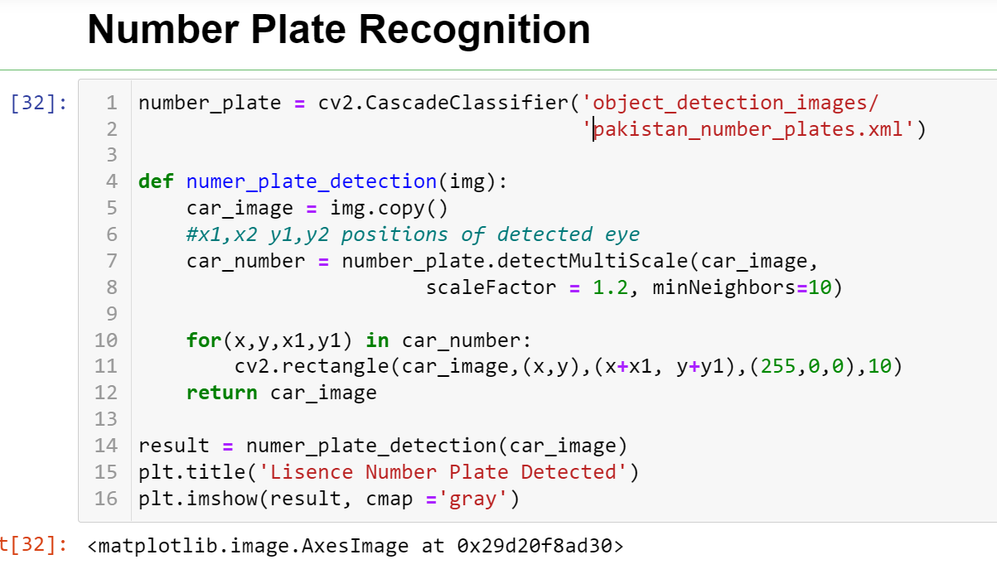

Slide 3
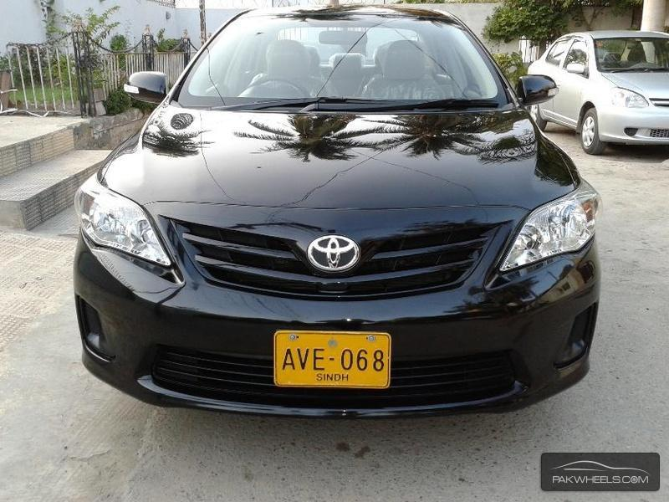
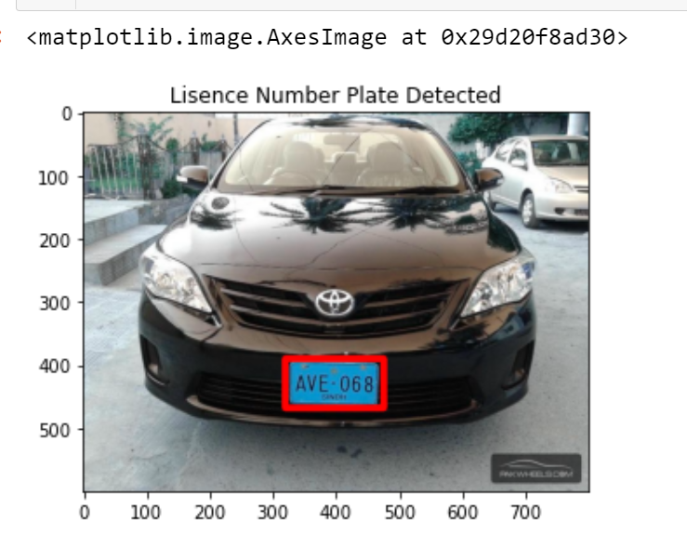
DETECTED NUMBER PLATE OF CAR
Original Image
Detected Number

Slide 4
Thank You
For supporting us !

